Slide 1


ATRIA INSTITUTE OF TECHNOLOGY BANGALORE-54, Karnataka DEPARTMENT OF COMPUTER SCIENCE & ENGINEERING (DataScience)
VISVESVARAYA TECHNOLOGICAL UNIVERSITY
“Jnana Sangama”, Belagavi– 590018
DSA Seminar on BINARY SEARCH TREE OPEARTIONS
UNDER THE GUIDANCE OF
Dr. K S Ananda Kumar
Associate Professor
Dept. of ISE, Atria IT
PRESENTED BY
SHUBHASHREE.S(1AT22CD052)
THANUSHRI.R(1AT22CD058)

Slide 2
BINARY SEARCH TREE OPERATIONS

Slide 3
CONTENTS
CREATING A NODE IN BINARY SEARCH TREE
INSERTING A NODE IN BINARY SEARCH TREE
SEARCHING A NODE IN BINARY SEARCH TREE
DELETING A NODE IN BINARY SEARCH TREE
TRAVERSAL OF A BINARY SEARCH TREE

Slide 4
What is BINARY SEARCH TREE ?
A BINARY SEARCH TREE WHERE THE ELEMENTS IN THE LEFTSUB TREE ARE LESSER THAN THE ROOT NODE AND THE ELEMENTS IN THE RIGHTSUB TREE ARE GREATER THAN THE ROOT NODE
EVERY NODE IN THE TREE MUST SATISFY THIS CONDITION ,IF THE LEFTSUBTREE AND RIGHTSUB TREE EXITS.

Slide 5
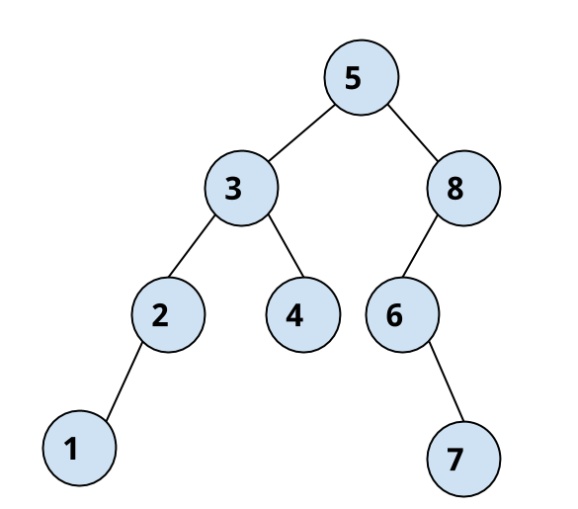
EX-

Slide 6
CREATING BINARY SEARCH TREE
Creating a binary search tree involves inserting nodes in a way that maintains the property that for each node:
All nodes in its left subtree have values less than the node.
All nodes in its right subtree have values greater than the node.

Slide 7
#include <stdio.h>
#include <stdlib.h>
// Node structure
struct Node {
int key;
struct Node* left;
struct Node* right;
};
// Function to create a new node
struct Node* createNode(int key) {
struct Node* newNode = (structNode*)malloc(sizeof(struct Node));
newNode->key = key;
newNode->left = newNode->right = NULL;
return newNode;
}

Slide 8
INSERTING A NODE IN BINARY TREE
1.If a tree or subtree does not exist, create a node and insert the value in it.
2.If the value we are inserting is less than the root of the tree, we move to the left subtree and start at step1 again.
3.If the value is greater than the root of the tree, we move to the right subtree and start at step1 again.
4.If the value is equal to the root of the tree or subtree, we do nothing because the value is already there. In this case we return.

Slide 9
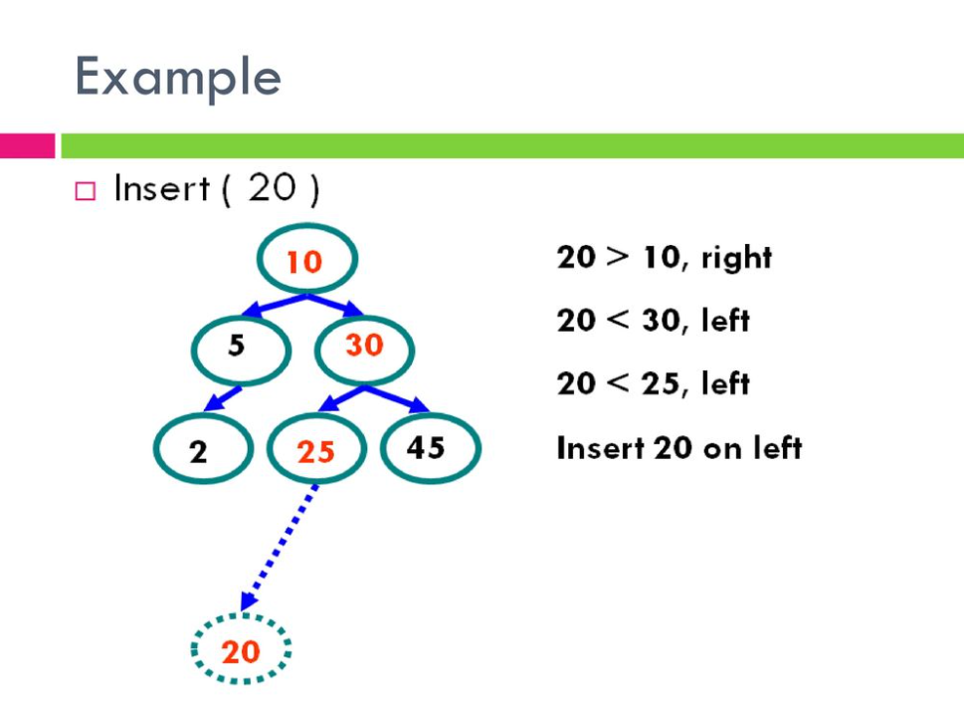

Slide 10
// Function to insert a key into the tree
struct Node* insert(struct Node* root, int key) {
// Base case: If the tree is empty, create a new node
if (root == NULL)
{
return createNode(key);
}
// Otherwise, recursively insert into the appropriate subtree
if (key < root->key) {
root->left = insert(root->left, key);
} else if (key > root->key) {
root->right = insert(root->right, key);
}
return root;
}

Slide 11
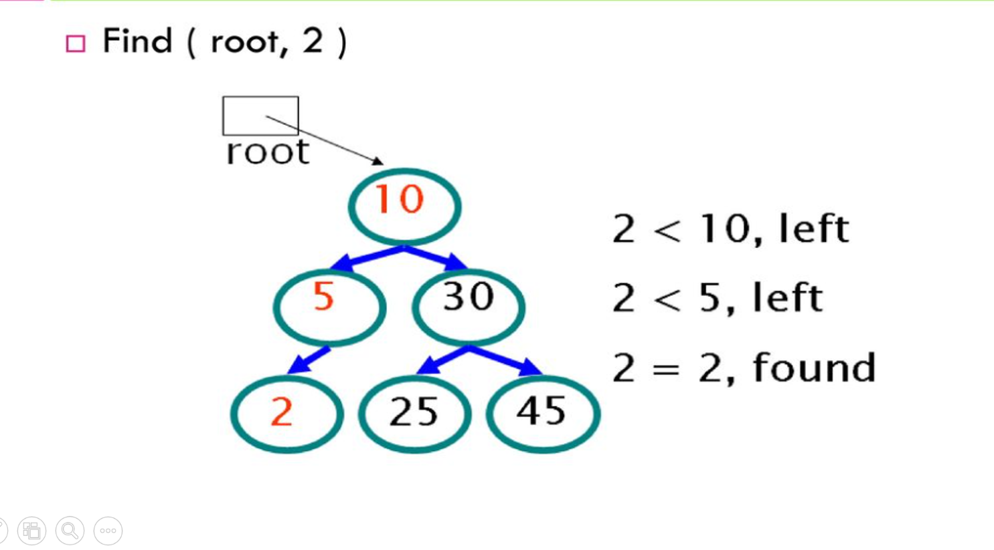
SEARCHING A NODE IN BINARY SEARCH TREE

Slide 12
// Function to search for a node with a specific key
struct Node* search(struct Node* root, int key) {
// Base cases: root is null or the key is found
if (root == NULL || root->key == key) {
return root;
}
// Key is smaller, search in the left subtree
if (key < root->key) {
return search(root->left, key);
}
// Key is larger, search in the right subtree
return search(root->right, key);
}

Slide 13
// Example usage
int main() {
struct Node* root = NULL;
int keys[] = {50, 30, 20, 40, 70, 60, 80};
// Insert keys into the tree
for (int i = 0; i < sizeof(keys) / sizeof(keys[0]); i++) {
root = insert(root, keys[i]);
}
// Search for a node with a specific key
int targetKey = 60;
struct Node* foundNode = search(root, targetKey);

Slide 14
// Check if the node is found
if (foundNode != NULL) {
printf("Node with key %d found in the tree.\n", targetKey);
} else {
printf("Node with key %d not found in the tree.\n", targetKey);
}
return 0;
}

Slide 15
DELETING A NODE IN BINARY SEARCH TREE
1.Perform search for value x
2.if x is a leaf, delete x
3.Else
> replace with largest value Y on left subtree
or
smallest value Z on right subtree
> delete replacement value (Y or Z) from subtree

Slide 16
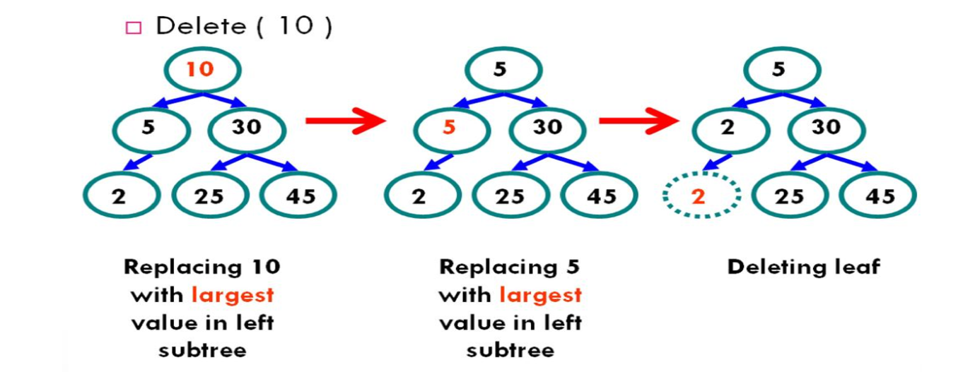
EX-

Slide 17
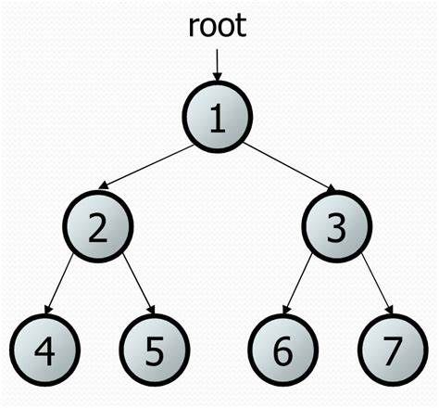
TRAVERSAL OF A BINARY SEARCH TREE
PREORDER
1,2,4,5,3,6,7
INORDER
4,2,5,1,6,3,7
POSTORDER
4,5,2,6,7,3,1

Slide 18
THANK YOU

